Slide 1

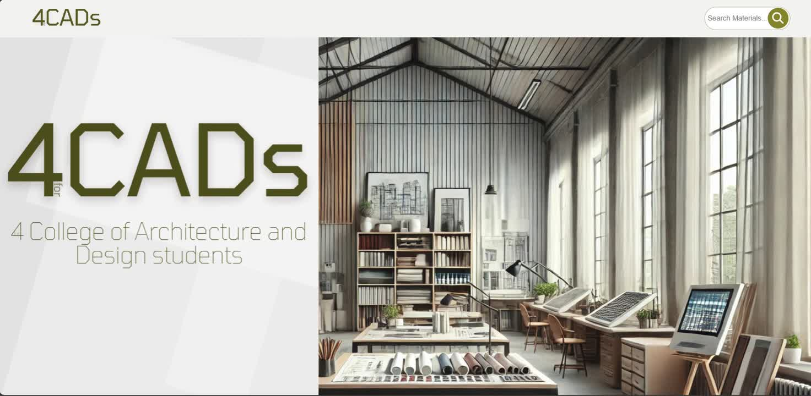
CLASS
PRESENTERS
CS104
Ray Sama, Juan D. Ahumada, Ganpath Ramesh, Damaris Espinoza,
4CADs
Launch Plan
for
Team Members:
Ray Sama (003)
Juan D. Ahumada (001)
Ganpath Ramesh (003)
Damaris Espinoza (003)

Slide 2

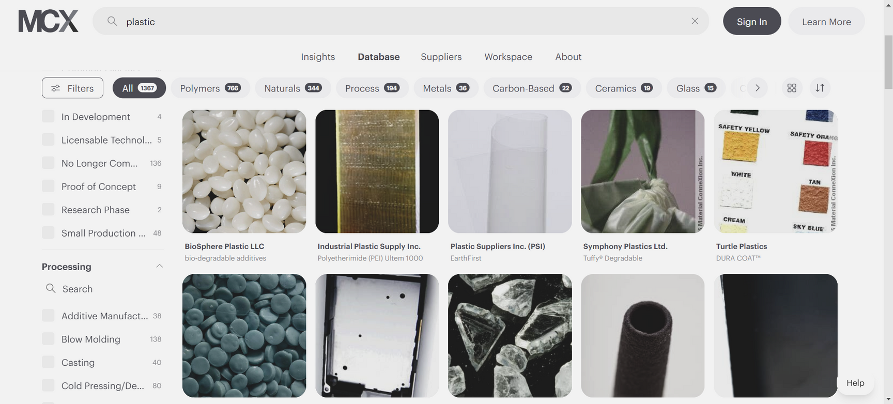
INTRODUCTION
Project Summary
Problem Statement
Design students do not necessarily have a dedicated, educational platform to learn about material properties, although, knowing this can help in making informed choices for their projects. Existing material catalogues don’t specifically target students’ learning needs. In other words, they do not guide nor introduce students to material selection skills
4CADs
for
NEXT

Slide 3
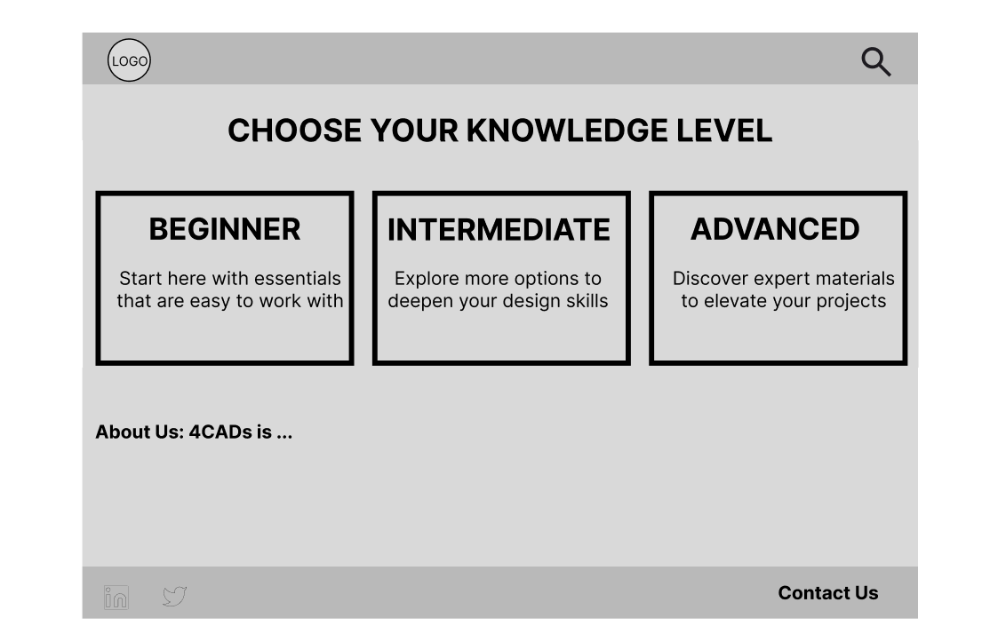
INTRODUCTION
Project Summary
What we’re building
4CADs is a website designed by 4 College of Architecture and Design students for students, especially those in design-related fields like Architecture or Industrial Design for instance. It addresses a challenge many early-stage designers face: finding reliable, educational resources for learning about materials that can meet their needs for academic or personal projects and even early professional work.
4CADs
for
for
NEXT

Slide 4
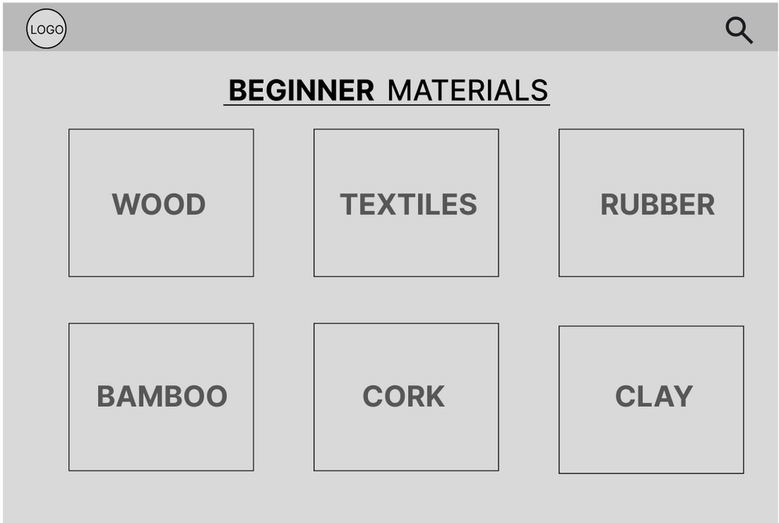
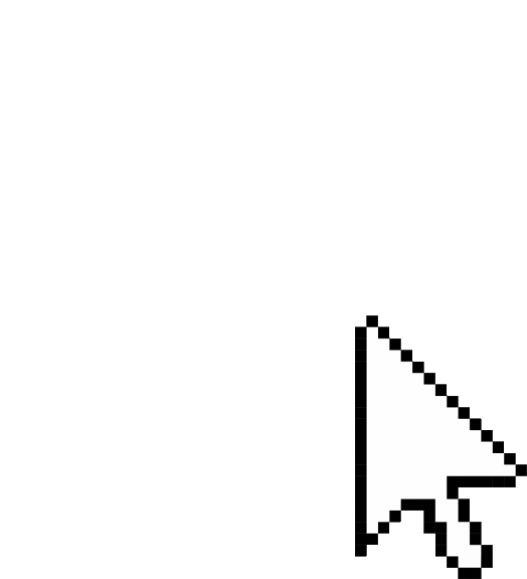
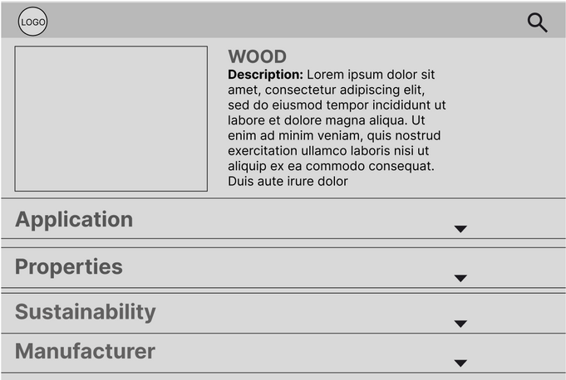
4CADs
How we started
1
2
for
Gathering Requirements
01
02
Functional
Non-Fuctional
3
Search bar
Level of Expertise Page
Material Catalog
Educational Content
Real-world uses & why
Material Properties
Manufacturers/Sellers
The interface should be intuitive and easy to navigate.
The website should be able to handle searches.
The website should be scalable, allowing for future growth as more materials are added.
for
NEXT

Slide 5
How we started
Gathering Requirements
Key Tasks
01
02
03
4CADs
Functional
Non-Fuctional
Organization
Search bar
Level of Expertise Page
Material Catalog
Educational Content
Real-world uses & why
Material Properties
Manufacturers/Sellers
The interface should be intuitive and easy to navigate.
The website should be able to handle searches.
The website should be scalable, allowing for future growth as more materials are added.
Created a detailed requirements document.
Finalized our project scope.
Created a code repository using GitHub
Created a detailed timeline for this project’s development.
for
for
NEXT

Slide 6
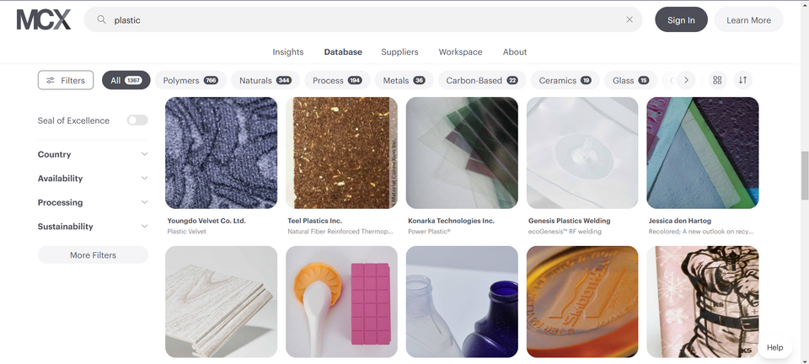
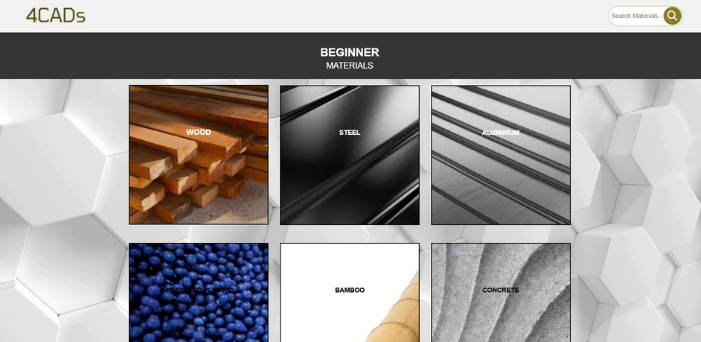
How we started
Gathering Requirements
Key Tasks
Requirement Analysis
01
02
03
4CADs
Functional
Non-Fuctional
Organization
Search bar
Level of Expertise Page
Material Catalog
Educational Content
Real-world uses & why
Material Properties
Manufacturers/Sellers
The interface should be intuitive and easy to navigate.
The website should be able to handle searches.
The website should be scalable, allowing for future growth as more materials are added.
Created a detailed requirements document.
Finalized our project scope.
Created a code repository using GitHub
Created a detailed timeline for thus project’s development.
www.materialconnexion.com
www.4CADs.com
for
for
NEXT

Slide 7
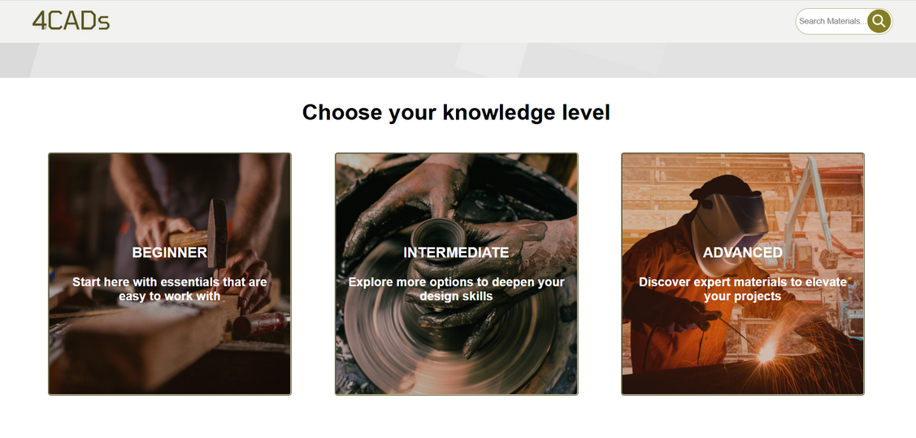
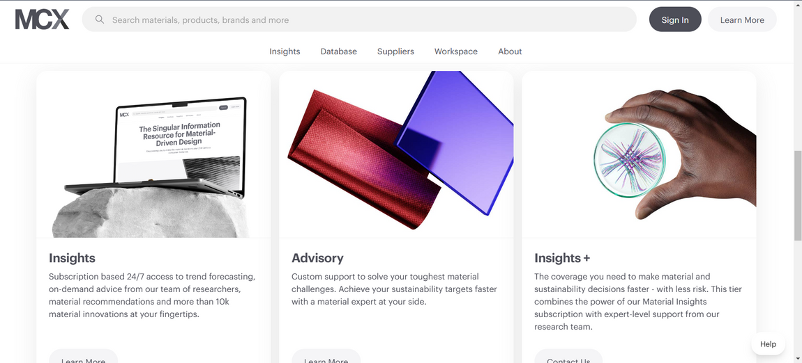
Analysis difference
www.4CADs.com
www.materialconnexion.com

Slide 8
Organisation of Tasks
Task
Priority
Stage
Design a Logo
Low-Fidelity Mockup
Basic HTML layout
Material Research
Cost Research
High Fidelity Mockup
Midterm PowerPoint Presentation
High
Medium
High
High
Low
High
High
Complete
Complete
Complete
Complete
Incomplete
Complete
Complete
4CADs
for
NEXT

Slide 9
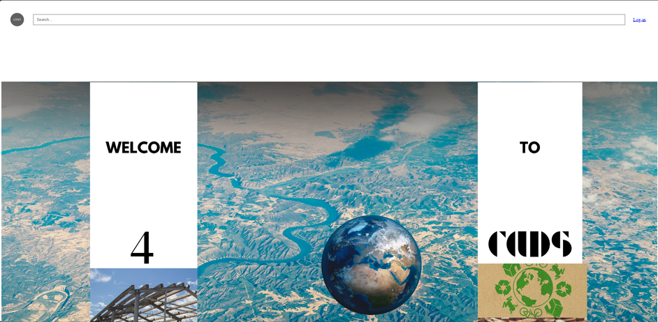
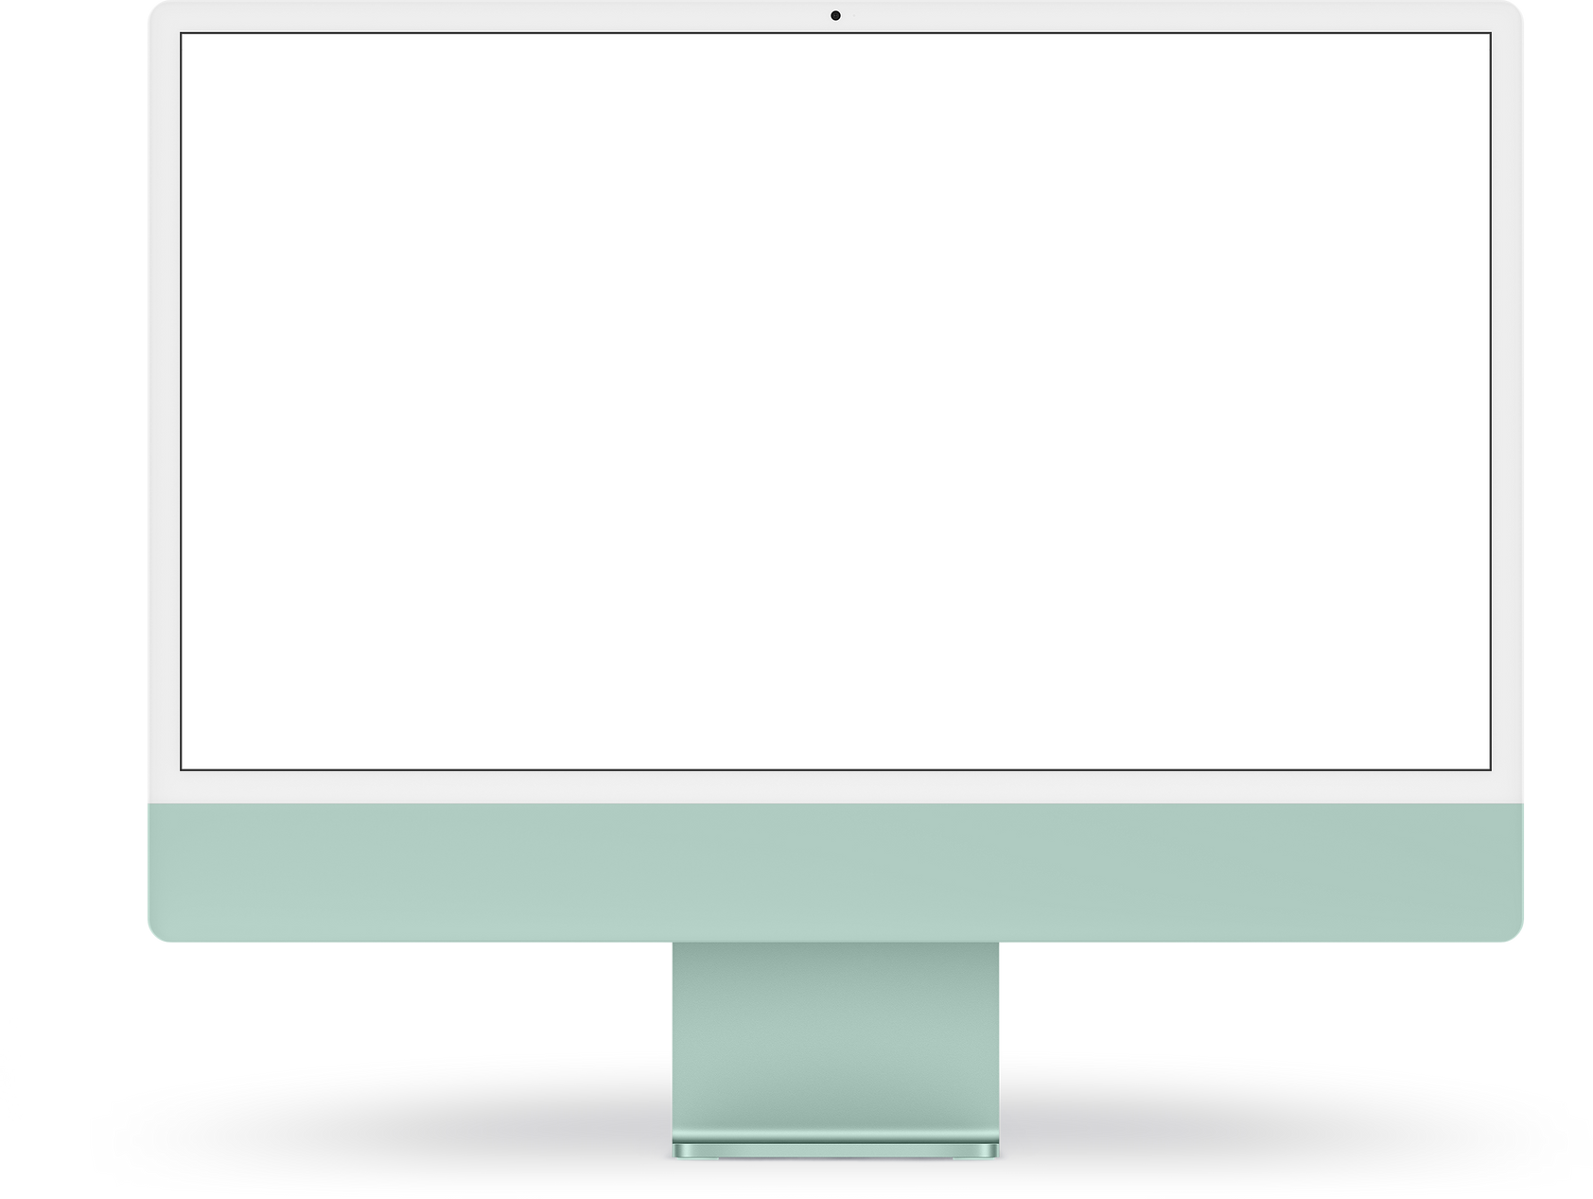
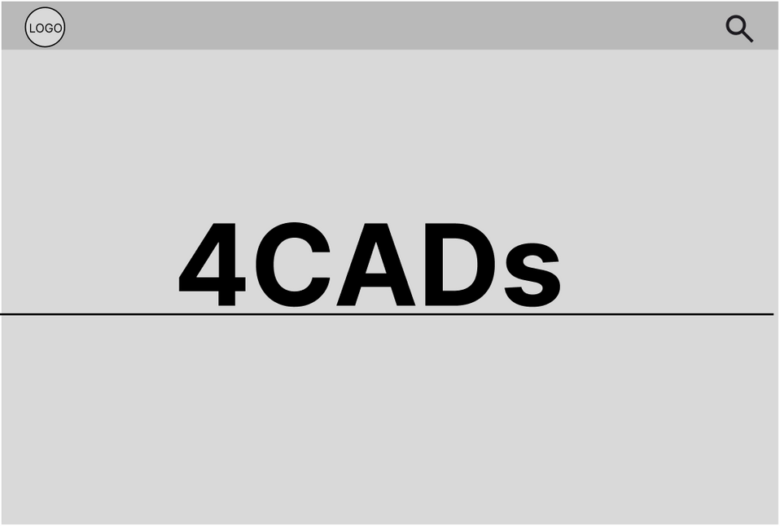
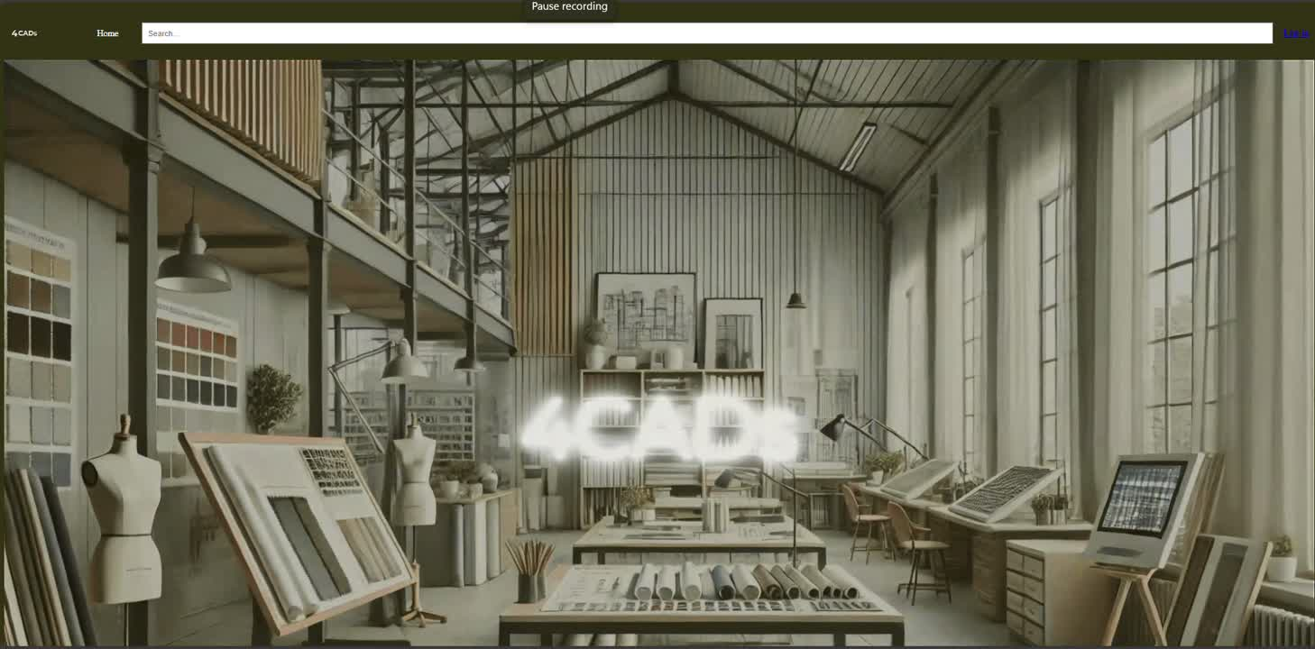
V1
Page 1
V2
MOCKUP
PRESENTER:
Ray Sama
ROLE:
PROJECT LEAD – COORDINATING PROJECT FLOW & WEBSITE AESTHETICS

Slide 10

Challenge
PROBLEM
SOLUTION
My attempts to place a background video that would continuously play on a loop were disappointed by the fact that every time I refreshed the page after adding the loop and autoplay attribute to my video tag the video would stop playing and stay still like an image
One solution to this was using the image tag, which accepted GIF so I exported the homepage video in GIF format and inputted the gif file as the sourced element, because GIF autoplay on its own, this was successful.
NEXT

Slide 11
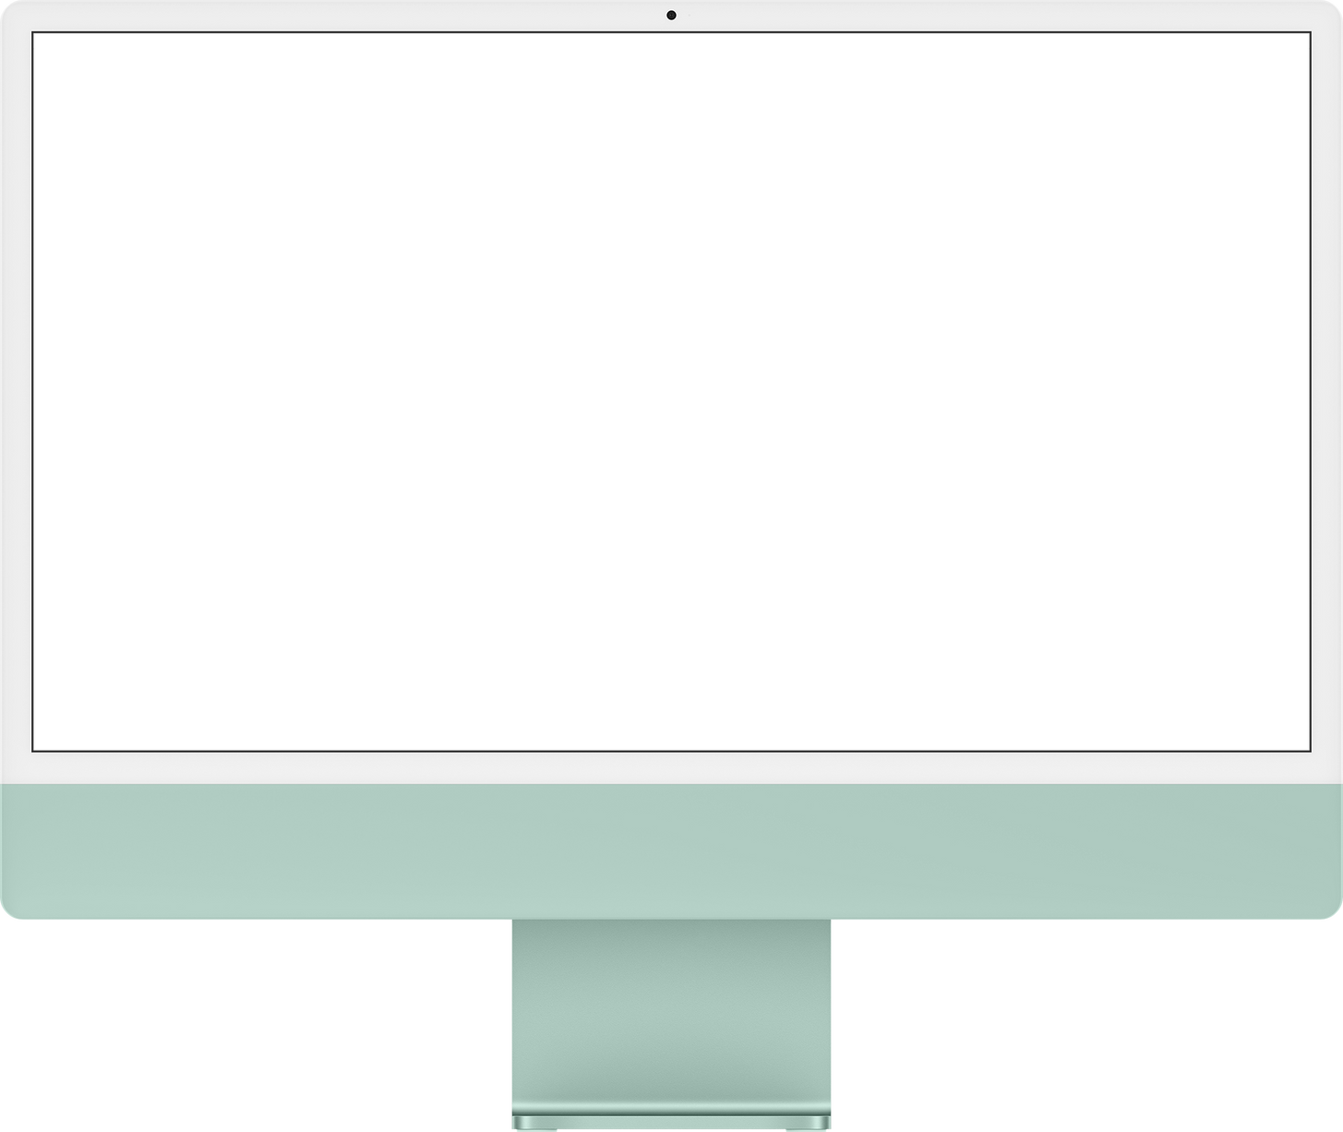
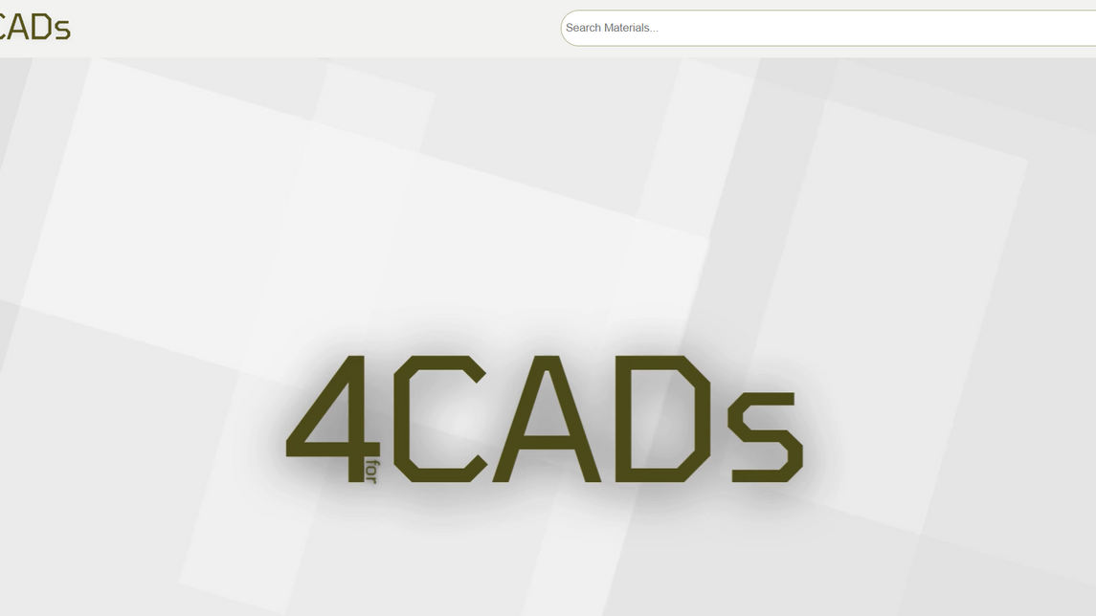
Current Page Layout
Animated Logo
Animated Search Bar
The Navigation bar’s logo increases its width when the mouse hovers over it
Using the focus attribute, on the search bar, I made the search bar expand on click.
Navbar sticks upon scroll
Video Background
I set the position for the navigation bar to sticky, and made it at 0px
Using the video tag, set to autoplay and loop, I used a video as the background for the homepage.

Slide 12
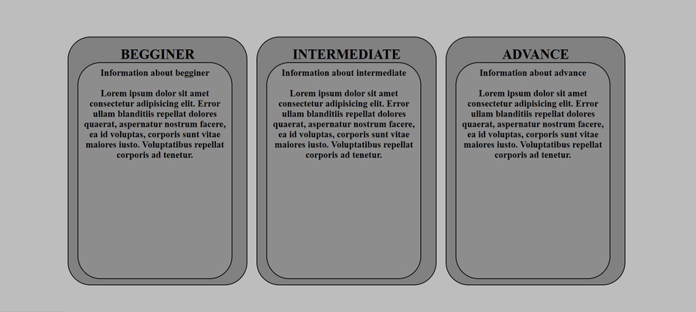
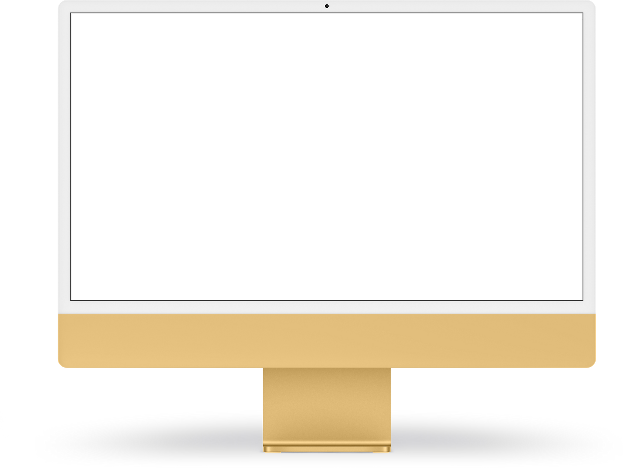
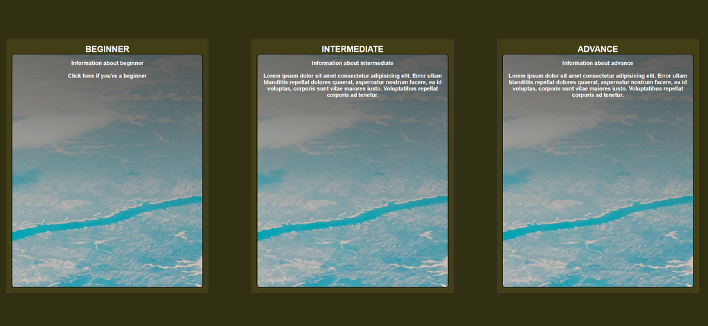
V1
PAGE 2
V2
MOCKUP
PRESENTER:
JUAN D. AHUMADA
ROLE:
WEB STRUCTURE DEVELOPER – DEVELOPED FOUNDATIONAL CODE FOR MULTIPLE WEBSITE STRUCTURES

Slide 13
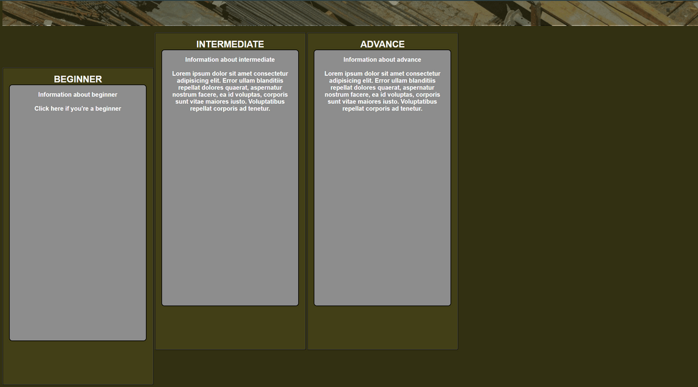
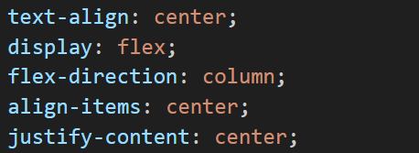
Challenge
PROBLEM
SOLUTION
The biggest problem I had was keeping the elements aligned and centered because they were always on top of each other or very close together.
The solution to this problem was achieved by using the different CSS commands. These allowed to align and give a better order to the elements and text.
NEXT

Slide 14
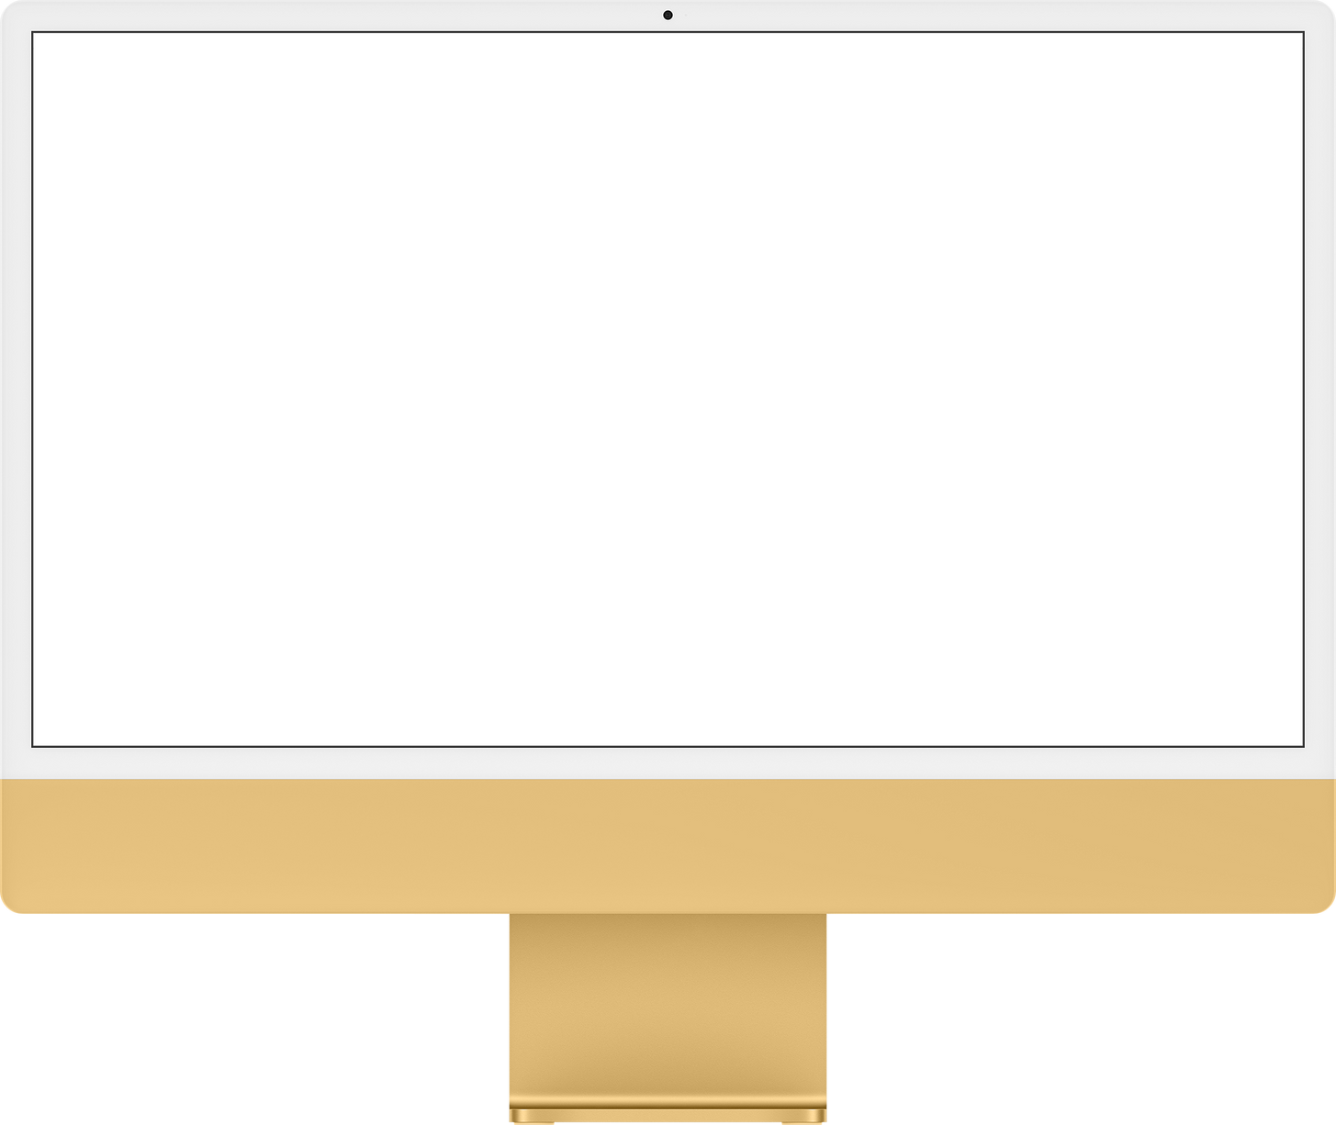
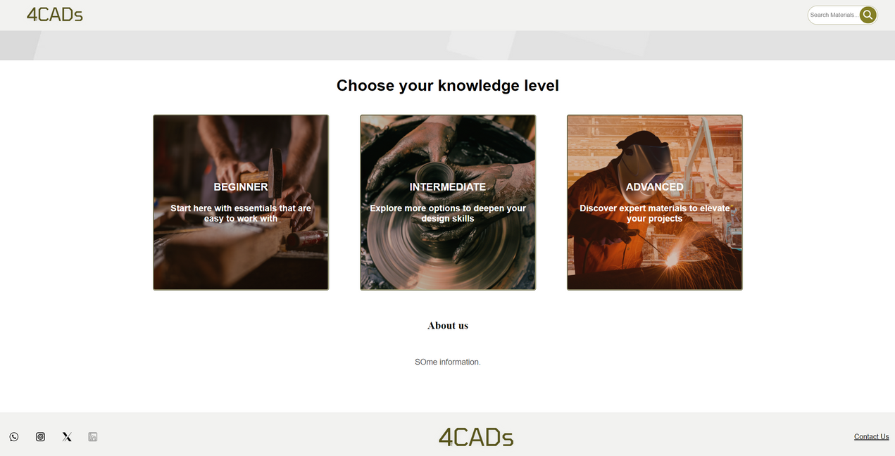
Current Page Layout
Improved Navigation Bar
The homepage navigation bar is kept because its position is "Sticky"
New Elements images
New images for the elements communicates the purpose of these.
Social Media Icons
These elements were added in case we are looking to increase our presence on social networks.

Slide 15
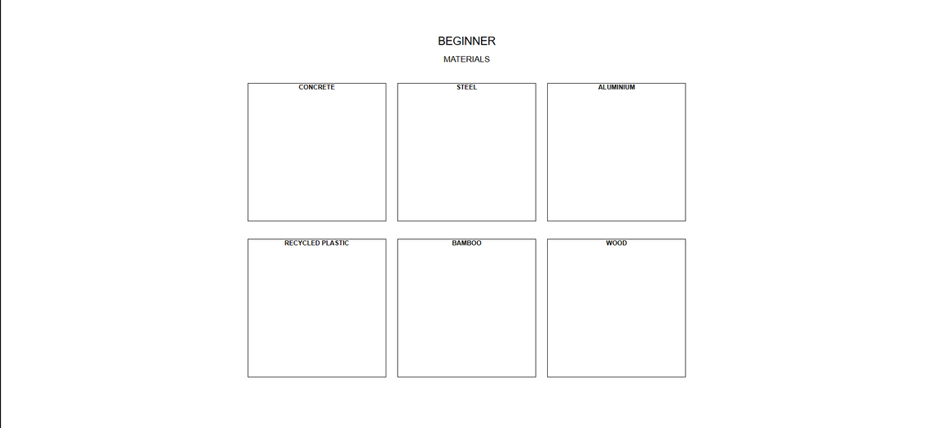
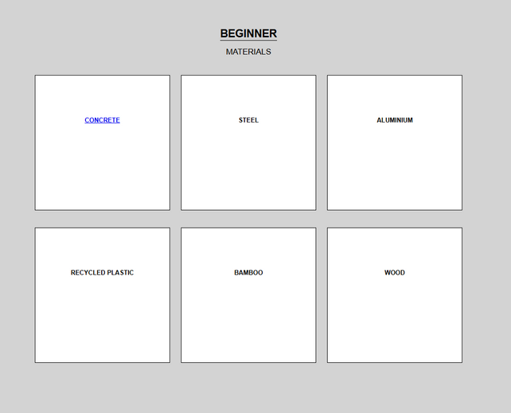
V1
PAGE 3
V2
MOCKUP
PRESENTER:
GANPATH RAMESH
ROLE:
UX CONSULTANT & DESIGN REVIEWER REVIEWS & PROVIDES FEEDBACK ON DESIGN ELEMENTS, OPTIMIZES THE SITE FOR A USER FRIENDLY EXPERIENCE.

Slide 16

Challenge
PROBLEM
SOLUTION
Making Features functional
Using “copy relative path”
NEXT

Slide 17
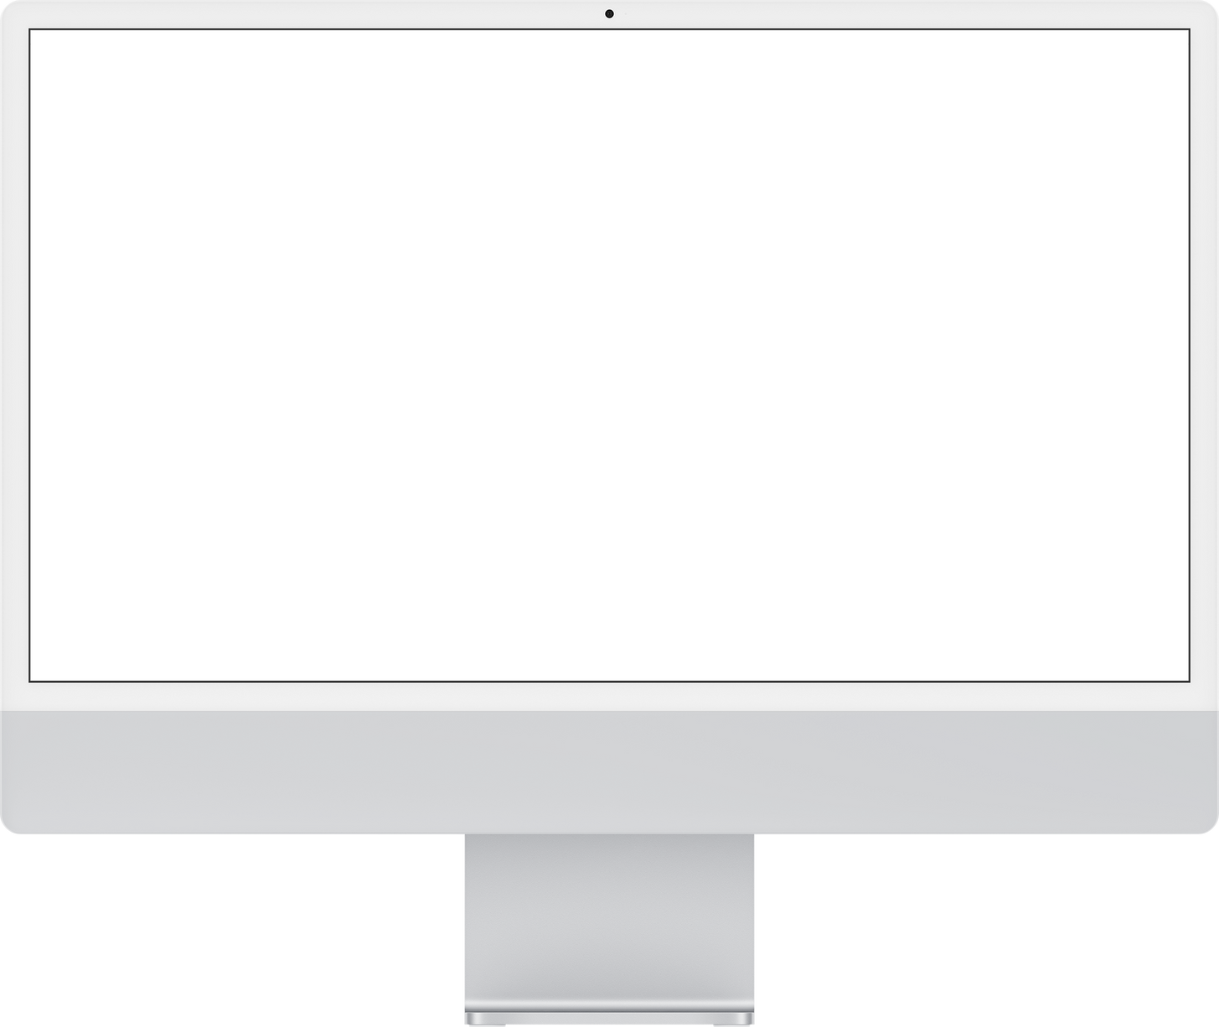
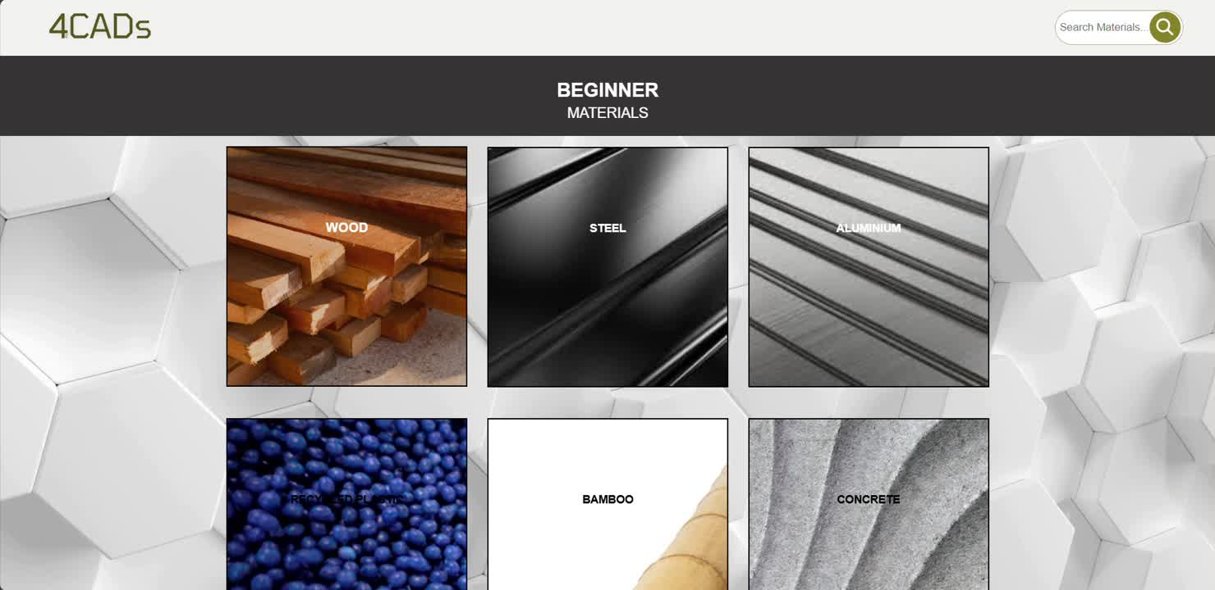
Current Page Layout
Funtionality
Making the website easy to navigate.
Visualization
Allowing user to visually see material.

Slide 18
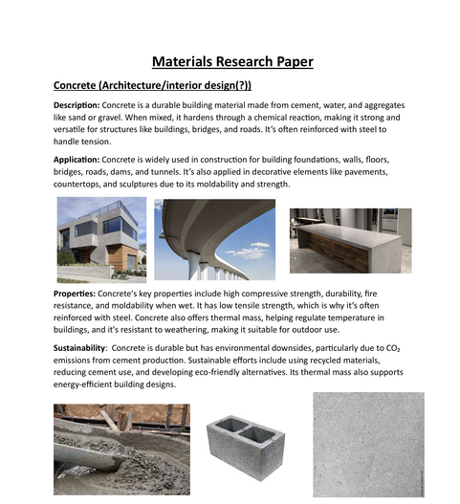
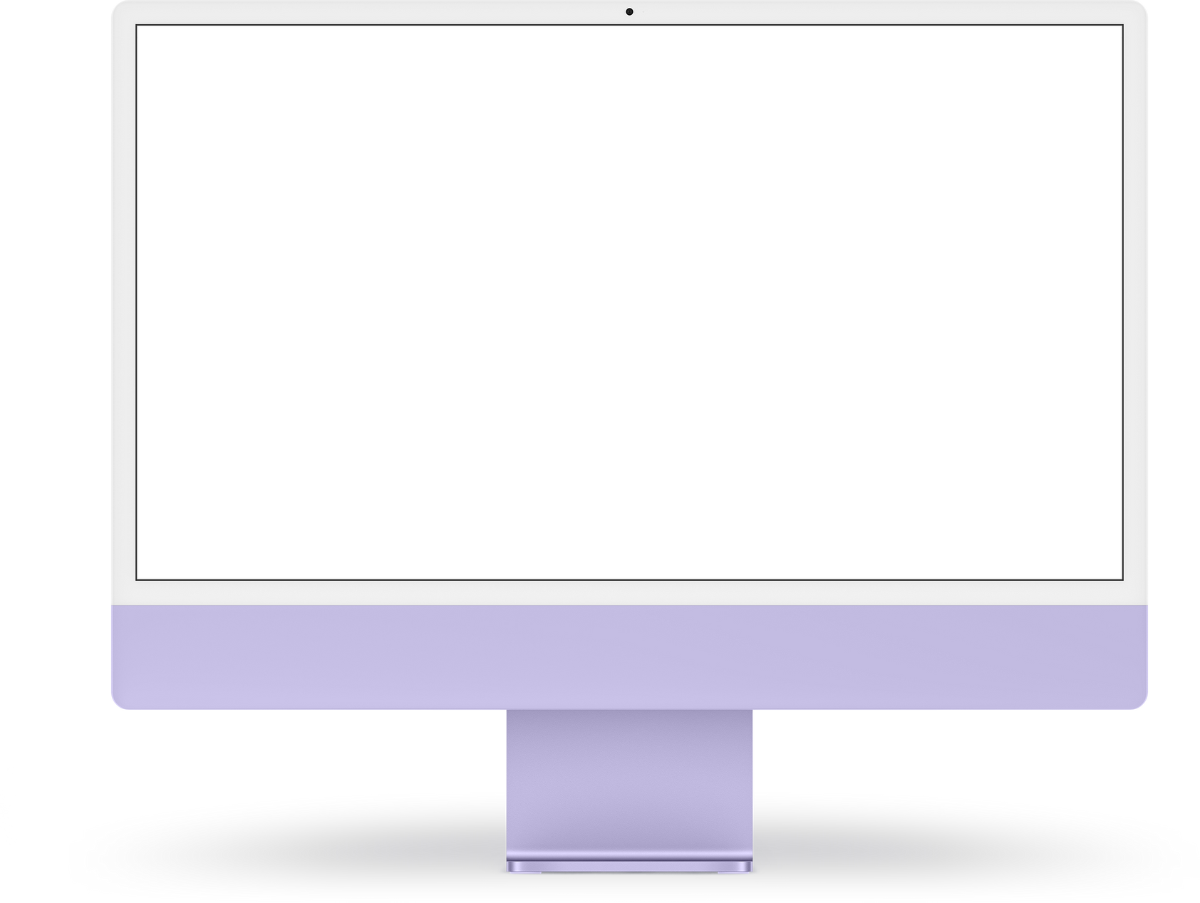

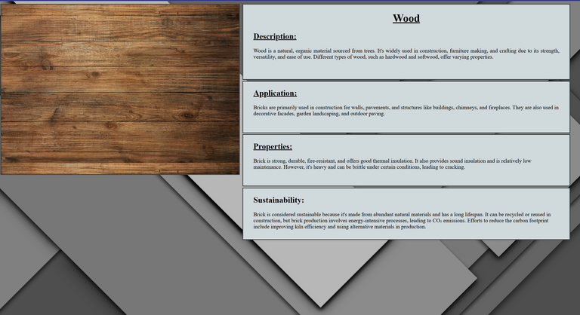
V1
PAGE 4
V2
MOCKUP
PRESENTER:
DAMARIS ESPINOZA
ROLE:
CONTENT RESEARCHER– CONDUCTED IN-DEPTH MATERIAL RESEARCH TO PROVIDE ACCURATE, RELEVANT CONTENT FOR THE SITE'S MATERIAL CATALOG.

Slide 19
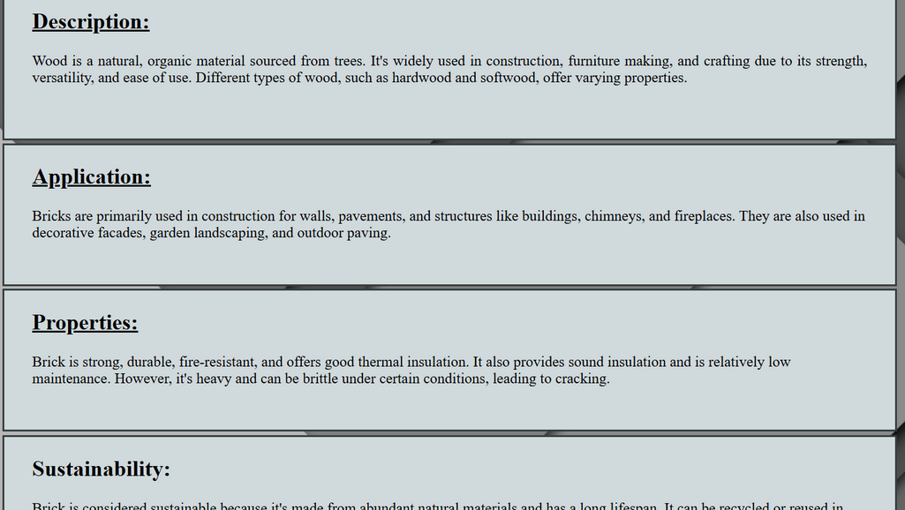
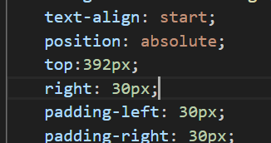
Challenge
PROBLEM
SOLUTION
Trying to make the correct spacing inside boxes
Researching the materials and finding out what they can be used for, how can they be applied and examples of the application.
Using position, padding and text-align.
Making sure the information doesn’t mix up.
NEXT

Slide 20
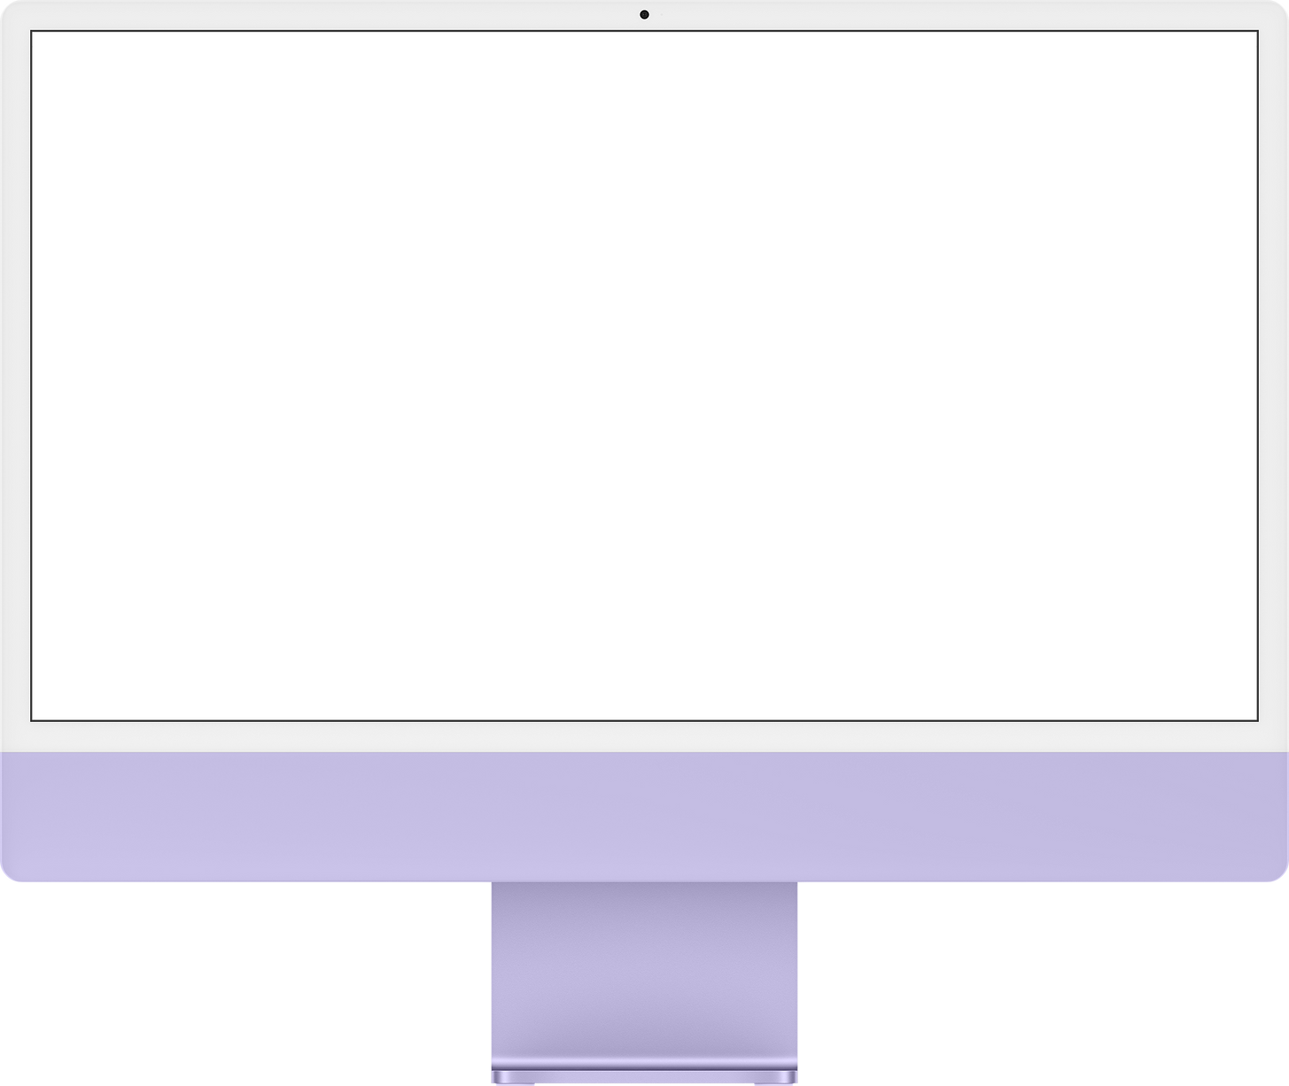
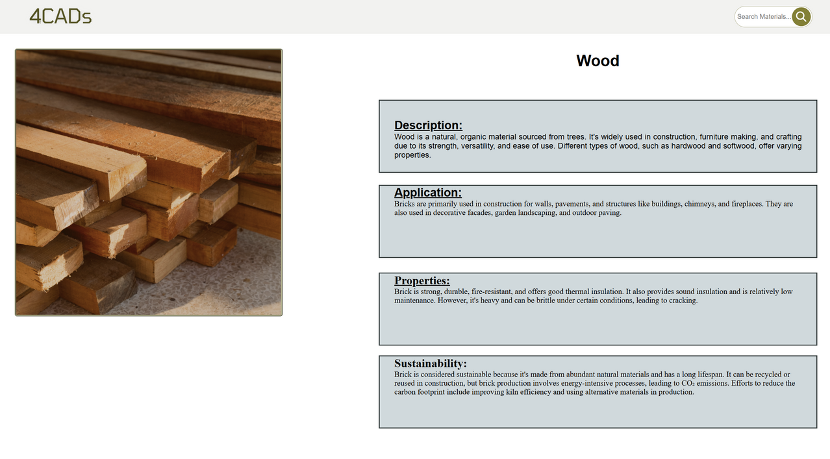
Current Page Layout
Title and Description
Material image
A brief description for the material provided.
A visualizing of the material provided
Future dropdown Features
Application, Properties and Sustainability will be future dropdown tittles, for now the text will not be hidden.

Slide 21
4CADs
Project Plan
01.
03.
05.
Ideation & Branding
Project Report 2
Project Report 3
Coceptualised
Submitted
Still to come
02.
04.
06.
Project Report 1
Midterm Presentations
Final Presentations
Submitted
Currently happening
This is how we plan to launch the website for the amount of resources(time) we have.
NEXT

Slide 22
4CADs
Project Timeline
Teams
1st Quarter
2nd Quarter
3rd Quarter
4th Quarter
Logo
Design
Low-Fi Mockups
Designing webpages
Development
High-Fi Mockups
Furnishing web pages
Launch
Testing/Releasing
NEXT

Slide 23
Thank You
4CADs
For viewing
for

